Slide 1
SALES FORECASTING AND DEMAND PREDICTION
Presenters:
Adel Madgy
Mohamed Ismail
Khaled Mohey Elden
Mohamed Hany

Slide 2
TABLE OF CONTENTS
01
06
Programming Languages
Project Idea
02
Project Wireframe
03
End Users & Features
04
Data Structure
07
Data Visualization
08
Machine Learning
09
Deliverables
05
10
Project Team
Data Preprocessing

Slide 3

01 PROJECT IDEA
The objective aims to build a machine learning model that predicts future sales and demand for products based on historical data.
We are using XGBoost for forecasting and a Dash dashboard for visualization.

Slide 4
02 PROJECT WIREFRAME
User Journey:
Select product.
View demand trends, actual vs. predicted, and forecast.

Slide 5
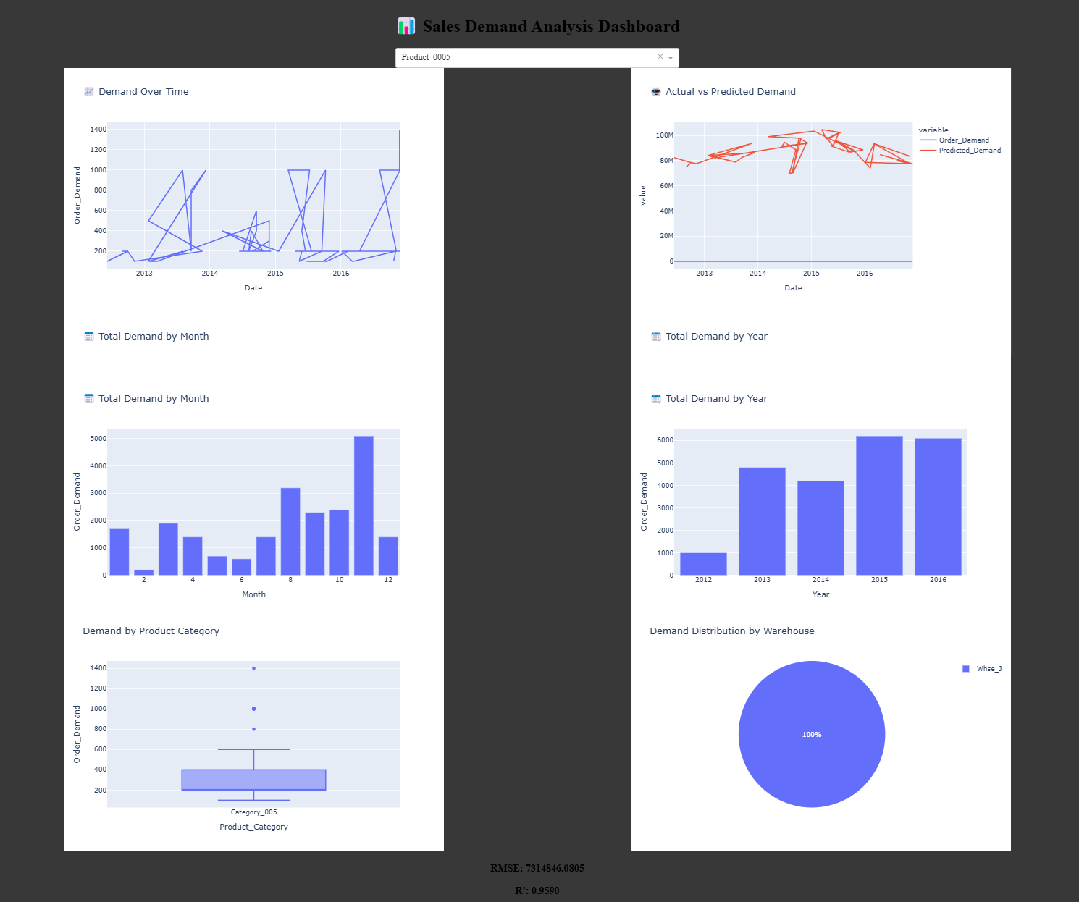
User Interface

Slide 6
Users
Key Features
03 END USERS & FEATURES
Retail Managers
Supply Chain Planners
Demand visualization
Predicted vs Actual comparison
Future sales forecast
User Value
Optimize stock and reduce shortages/overstock.

Slide 7
04
DATA STRUCTURE
Dataset Name: Historical Product Demand
Total Records: 1,048,575
Columns:
Product Code (2160 unique values)
Warehouse (4 unique values)
Product Category (33 unique values)
Date (Some missing values: 11,239)
Order Demand (Contains non-numeric characters)

Slide 8
Typecasting
Order-Demand Cleaning
05 DATA PREPROCESSING
Convert Date to date/ time format and drop NA values
Remove non-numeric characters
Convert to numeric
Drop missing and zero/negative values
Year
Month
Day
Weekday
Lag and rolling features
Feature Engineering

Slide 9
Languages
Frameworks
06 PROGRAMMING LANGUAGES
Python
RandomForest
Mlflow
Flask
Dash
Plotly
XGBoost
Joblib for model storage
Supporting

Slide 10

07 DATA VISUALIZATION

Slide 11
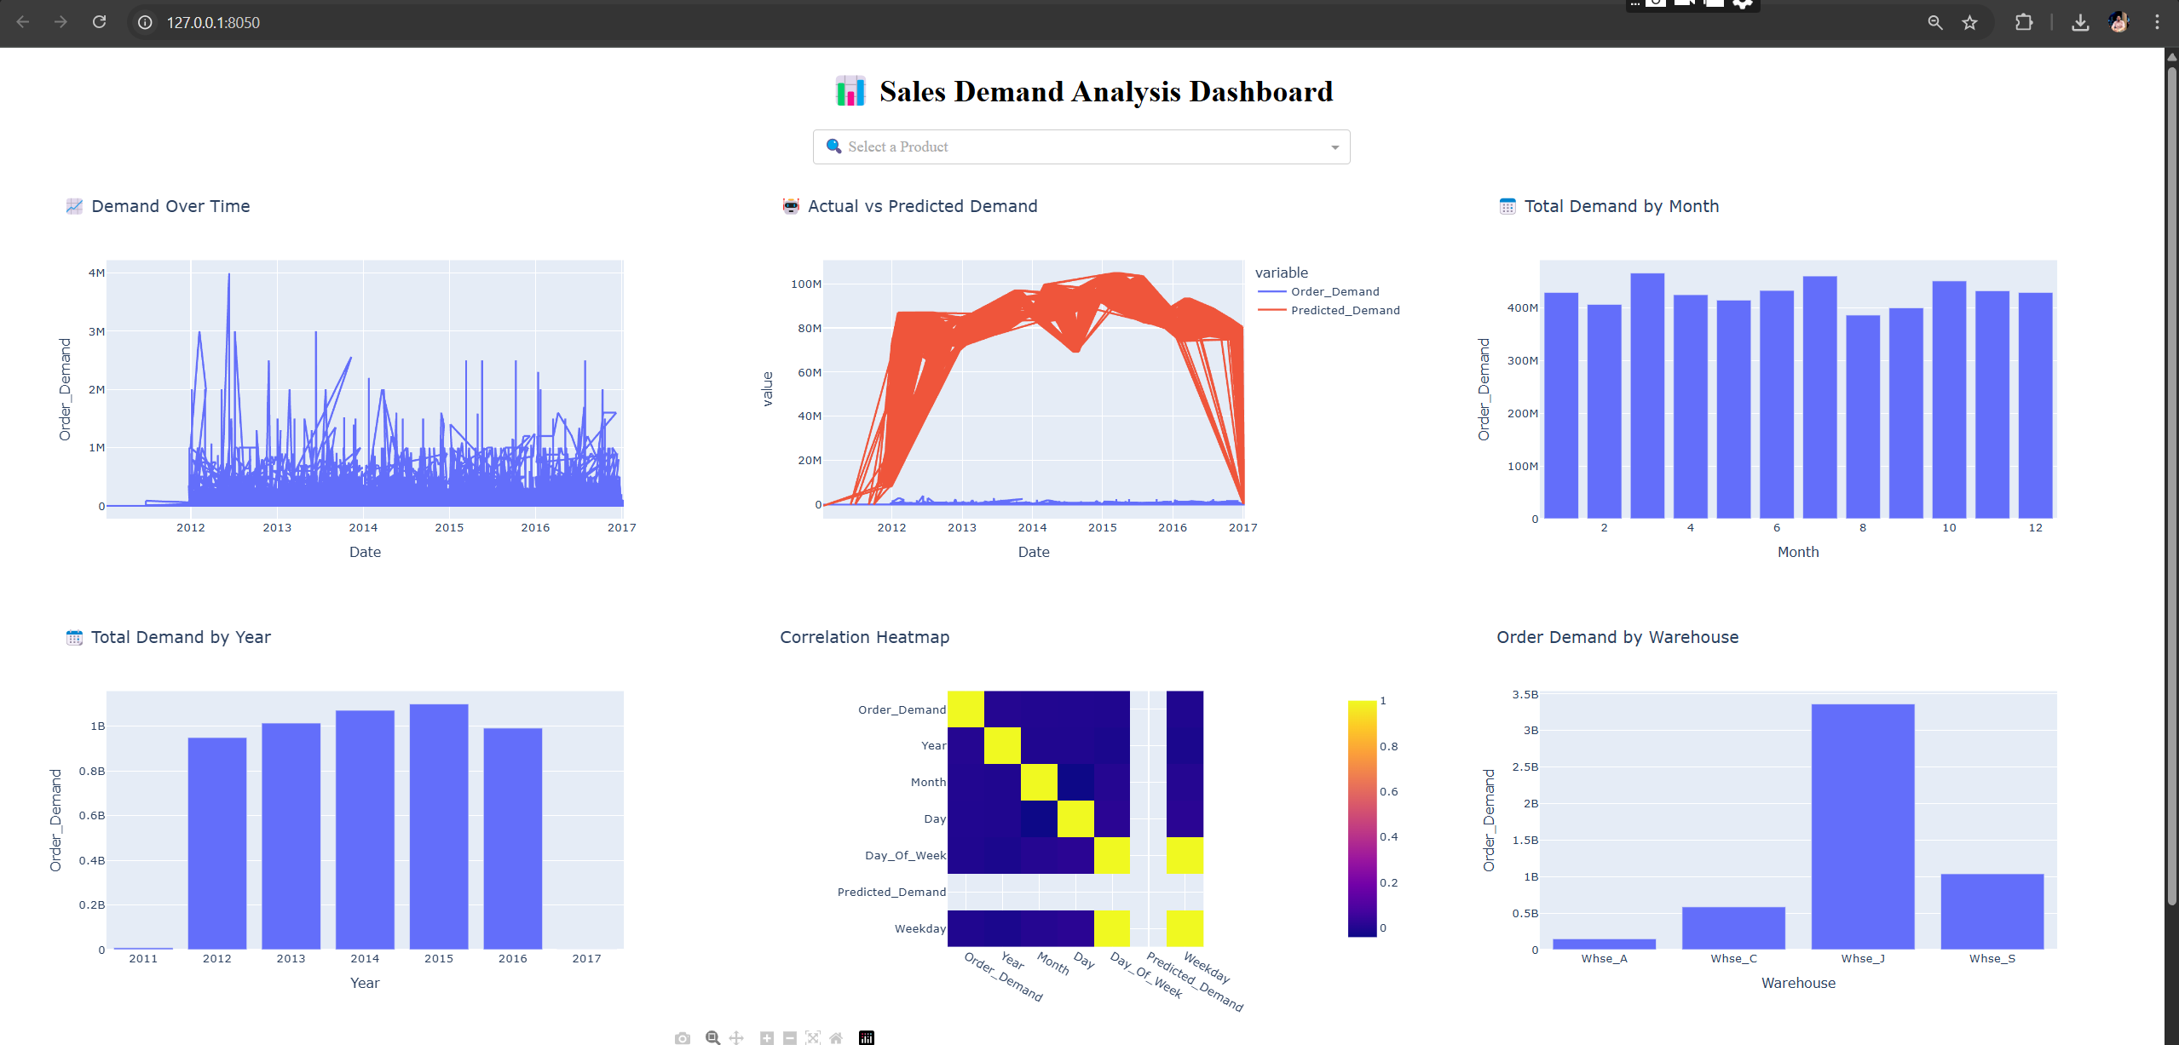
Dashboard

Slide 12
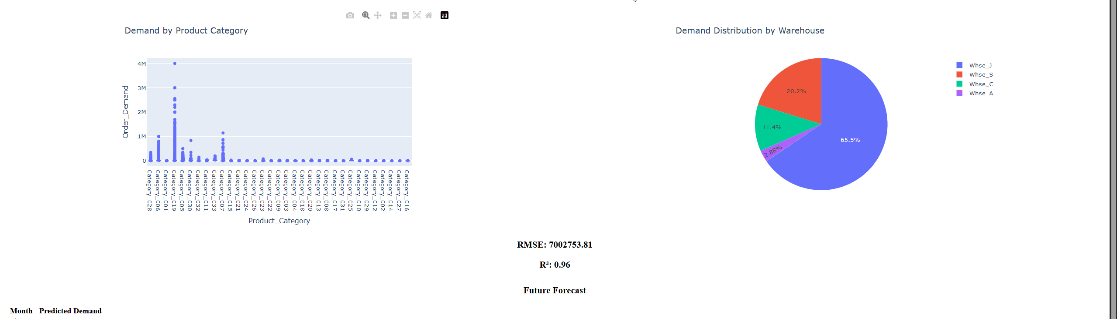

Slide 13
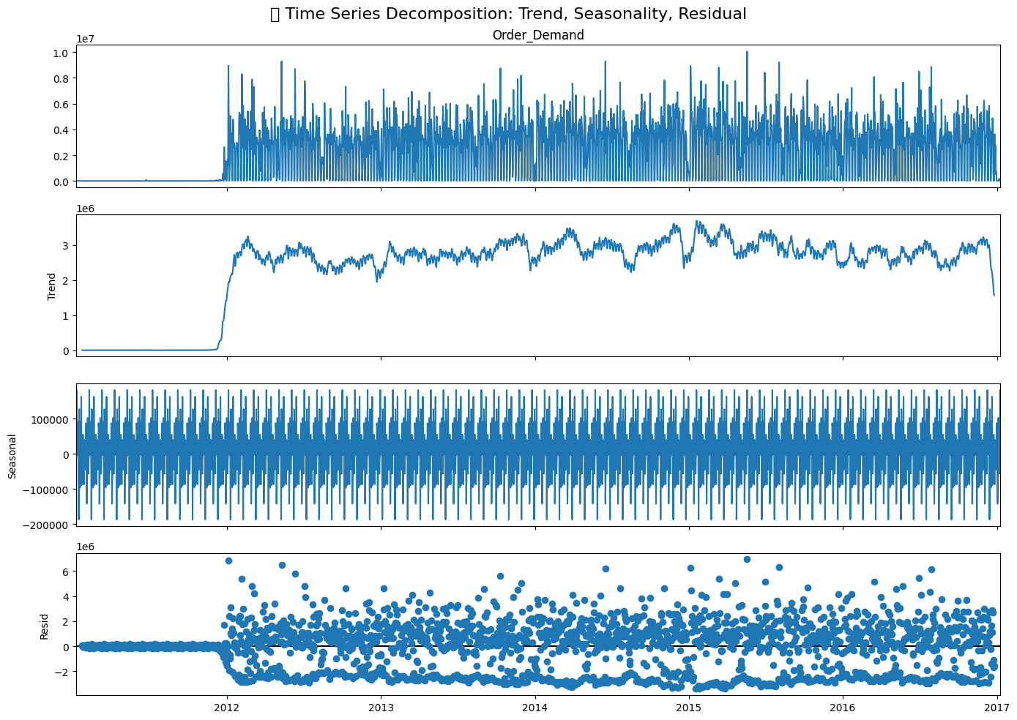
Timeseries Analysis Decomposition

Slide 14
08
MACHINE LEARNING
 | XGBoost | RandomForest
RMSE | 6659709.63 | 7314846.08
R2 | 0.97 | 0.96
Custom Success Rate | 64.29% | 64.29%

Slide 15

09 DELIVERABLES
report containing project details including procedure, techniques, and results.
PowerPoint presentation
Github link to the project files and the python code Project Link: KhaledMoheyD/Sales-Forecasting-and-Demand-Prediction: This is a team project in data science track in Digital Egypt Pioneers Initiative

Slide 16
10 TEAM MEMBERS
Team Member | Role
Mohamed Ismail (Team Leader) | Feature engineering, and model training
Khaled Mohey | Data Exploration, analysis
Adel Magdy | Model Selection and evaluation
Ahmed Hassan | MLops and model deployment
Youssef Adel | hyperparameter tuning
Mohamed Hany | Data Visualization

Slide 17
THANK YOU

